Slide 1
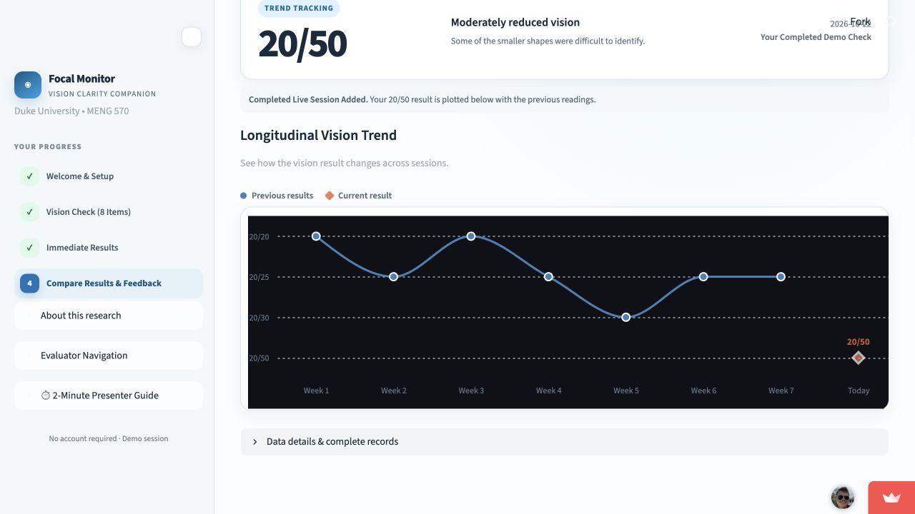
Focal Family
Investor pitch
A prepared next step for parents
Focal Technologies Team 5
Haydn, Fan, Qingyi, Burak and Hadley
01
Notes:
01
Presenter: Haydn
Timing: 0:00–0:25 (25 seconds)
A school vision letter tells a parent that something needs attention. The family still has to understand it and take the next step. Focal Family helps them prepare. We are seeking $600,000 to test that workflow and build a product schools could buy, with free access for families.
Sources and assumptions
Team-selected product direction, October 30, 2026. Proposed investment terms and model.json.

Slide 2
The gap after a school vision letter
A parent still has to act
Evidence from a U.S. randomized trial
Pat receives a letter.
Finding care and preparing
the next conversation
still take work.
48% usual follow-up
65% enhanced
parent communication
162 children in Michigan. Eye exams documented within 16 weeks.
Musch et al., 2020; study conducted in 2017. The intervention was enhanced communication, not Focal. Pat is illustrative.
02
Notes:
The gap after a school vision letter
Presenter: Fan
Timing: 0:25–1:05 (40 seconds)
Imagine Pat receiving a school vision letter. Finding care and preparing questions still take work. A U.S. randomized study followed 162 children after failed school screening. Within sixteen weeks, documented eye examinations reached 65 percent with enhanced parent communication, compared with 48 percent under usual follow-up. That supports improving communication. It does not prove Focal works, or validate our home task. Our opportunity is to help families turn the letter into action.
Sources and assumptions
https://headstart.gov/publication/vision-screening-referrals
Customer-discovery workbook: Parent Pat is a hypothetical persona, not an observed customer journey.
https://www.sciencedirect.com/science/article/pii/S1091853120300483
Musch et al., Journal of AAPOS 24(2), 2020, DOI 10.1016/j.jaapos.2019.12.012. Wayne County, Michigan, study conducted 2017; n=162; 52/80 versus 39/82 completed documented eye examinations within 16 weeks. This is external intervention evidence, not Focal performance.
https://nc.preventblindness.org/wp-content/uploads/sites/14/2023/06/2023-24-Participant-Guide.pdf

Slide 3
Parents use it. Schools are the proposed buyer
The user
The proposed buyer
Parents of children
aged 4–10
District student services
School nurse champion
Initial focus: families following up after a school vision letter.
Proposed license: parent preparation, permitted follow-up status and staff reporting.
5 real interviews, including 1 parent; 5 AI simulations. School reporting is future work. Buyer demand and price remain untested.
03
Notes:
Parents use it. Schools are the proposed buyer
Presenter: Fan
Timing: 1:05–1:40 (35 seconds)
Our first users are parents of children aged four to ten after a school vision letter. District student-services leaders are the proposed buyers, with school nurses as champions. The proposed license adds parent preparation, permitted follow-up status and staff reporting. Reporting still needs building. Discovery included five real interviews, only one with a parent, plus five AI simulations. School demand and pricing remain unvalidated.
Sources and assumptions
docs/research/customer-discovery/interview-workbook.docx: Fan, My Mother, in-person interview
docs/research/customer-discovery/presentation.pptx: slides 2 and 6
School buyer and purchasing case are proposed hypotheses.
The school license and reporting are proposed future deliverables, not existing customers or a deployed school-facing product.

Slide 4
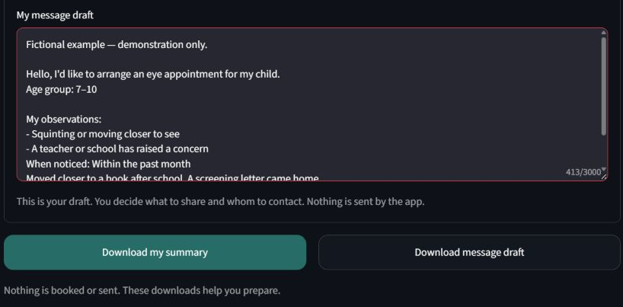
A prepared next step after a school letter
At home, parent assisted
Match screen size to a card.
Measure the viewing distance.
The child points; the parent taps.
A note ready for the next conversation
Capture observations, choose a next step and download an editable note.
Actual app screenshot with fictional example data. Parents edit and share the note themselves. Nothing is booked or sent; the task is not clinical screening.
04
Notes:
A prepared next step after a school letter
Presenter: Qingyi
Timing: 1:40–2:15 (35 seconds)
Here is how the check works: match the screen reference to a card and measure the viewing distance. The child points to the direction and the parent taps. Results describe a practice task, not clinical eyesight. The useful output is a parent-controlled note with observations and a chosen next step. This actual screenshot contains fictional example data. Nothing is booked or sent.
Sources and assumptions
https://focal-demo-b.streamlit.app/
Actual public-app screenshot captured November 4, 2026 after Explore a fictional example. The message contains the on-screen fictional-example label. No participant data, booking or message transmission.
Prototype B README and current public user interface. Task output does not establish clinical acuity.

Slide 5
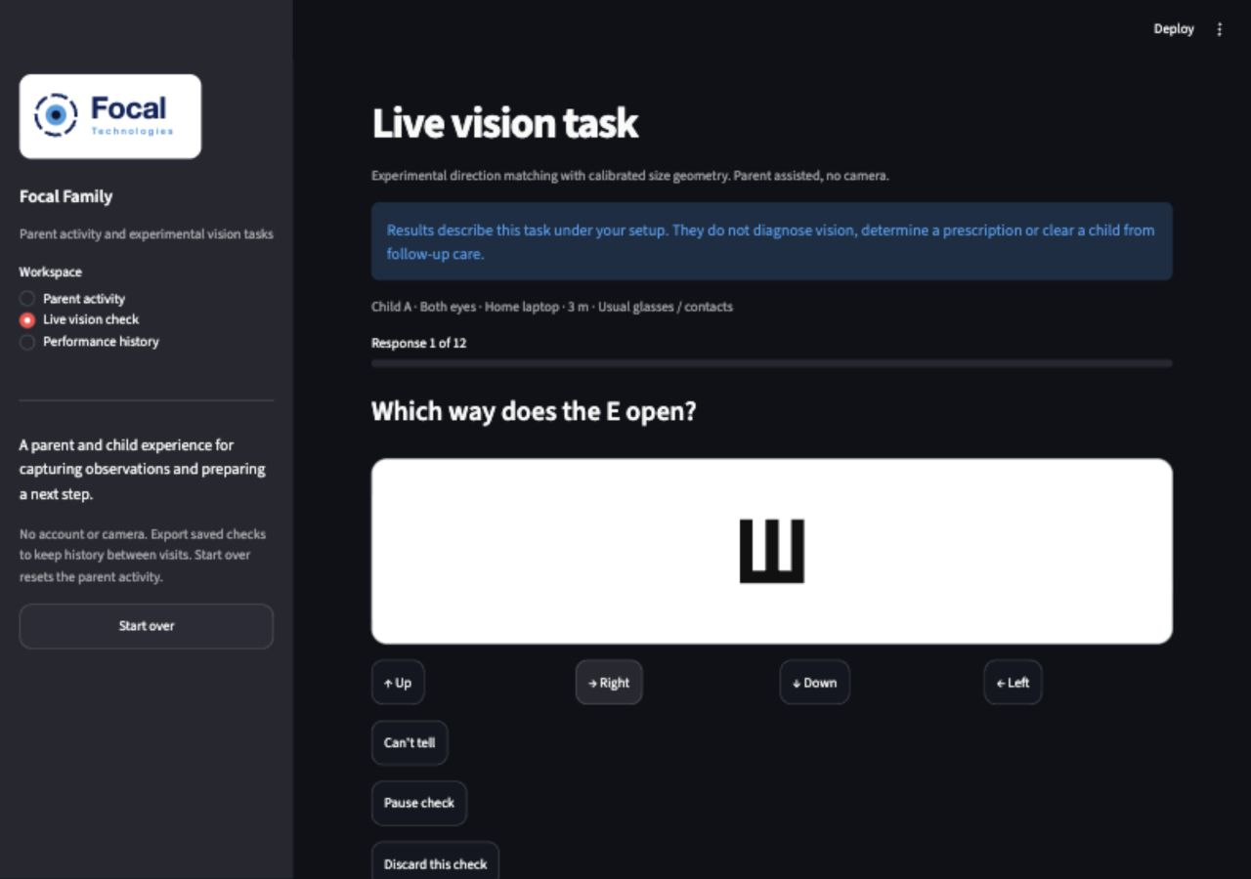
Focal Family live demo
3 minutes
Open the live Family demo
0:00 Set up and practice
0:35 Complete a check
1:30 Save and compare
2:15 Prepare the next step
Live check: software demonstration. Example history and parent note: clearly labelled fictional data.
05
Notes:
Focal Family live demo
Presenter: Qingyi 90 seconds, Burak 90 seconds
Timing: 2:15–5:15 (180 seconds)
Qingyi, first 90 seconds. Use https://focal-demo-b.streamlit.app/ with a prepared, measured setup. At 0:00 select Live vision check and show the card reference, eye choice and distance. Say that the child points and the parent taps; these are software-test responses. By 0:35 complete practice. At 0:35-1:20 answer all twelve randomized directions, using Can't tell once. At 1:20-1:30 show the breakdown, save once and hand over. Do not read a predetermined answer sequence.
Burak, next 90 seconds. At 1:30-1:50 show My saved checks and explain that a past-window comparison requires earlier records. At 1:50-2:15 explicitly switch to Fictional example history, show one window and say the records are made up. At 2:15 open a SECOND prepared tab at Parent activity, Explore a fictional example, Add questions and prepare a message. Show the action checklist, editable draft and download controls. Explain that the parent chooses what to share and nothing is booked or sent. Finish at 3:00 and return to slide 6.
Prepare both tabs before presenting. Keep live task responses, fictional history and the fictional parent-note example distinct. If the app stalls for ten seconds, use the task screenshot on this slide and the fictional note screenshot on slide 4. Finish within three minutes.
Sources and assumptions
https://focal-demo-b.streamlit.app/
Public Prototype B with Parent activity, Live vision check and Performance history, observed November 4, 2026. Two tabs keep the separate fictional parent-note example distinct from the live check. Preload and recheck before class. No switch to the master prototype is assumed.

Slide 6
The investment tests follow-through
Working today | What the investment adds
12-response direction task | Usability and repeatability study design
Saved checks and 7 / 30 / 90-day history | 10-site pilot of family action and staff effort
Parent observations and editable note | School follow-up status and staff reporting
Pilot gate: +15 percentage points in completed next steps
Proposed target versus usual information at 30 days. No completed pilot, paying customer or clinical validation is claimed.
06
Notes:
The investment tests follow-through
Presenter: Burak
Timing: 5:15–6:00 (45 seconds)
We have a working parent experience. Funding buys evidence and the school product. First we test independent use and repeatability. A proposed ten-site feasibility pilot then compares usual referral information with information plus Focal. We measure completed next steps at thirty days and staff effort, separating parent reports from verified actions. A fifteen-percentage-point improvement is a proposed decision gate. School follow-up status and reporting are funded work. Clinical accuracy would require separate validation.
Sources and assumptions
Prototype capabilities: prototypes/prototype-b-parent-guided-check/README.md
Pilot size, endpoints, and success gates are proposed targets. No completed pilot or signed customer is documented in the repo.
New testing/history modules demonstrate software behavior only. Clinical accuracy and repeatability are not established.

Slide 7
Our focus is the parent action after referral
Alternative | What it does well | Where Focal would compete
Letters and staff calls | Familiar, personal contact | An editable parent note and action checklist between school contacts.
GoCheck Kids | Professional screening and EHR integration | Preparation for families at home, alongside professional screening.
Peek Vision | Screening, referral tracking and reminders | Test whether the parent workflow is easier to complete and act on.
Differentiation to test: parent completion and less staff effort. Peek already has referral tracking and reminders. Sources in notes.
07
Notes:
Our focus is the parent action after referral
Presenter: Fan
Timing: 6:00–6:40 (40 seconds)
Letters and calls offer familiar personal contact. Focal adds an editable note and checklist between those contacts. GoCheck Kids provides professional screening and clinical-record integration; our preparation tool would work alongside that. Peek already offers referral tracking and reminders, so we cannot claim those as unique. Our focused question is whether parents complete the workflow and schools spend less time following up. That advantage has to be demonstrated through a pilot and renewals.
Sources and assumptions
https://headstart.gov/publication/vision-screening-referrals
https://www.gocheckkids.com/
https://peekvision.org/
https://peekvision.org/wp-content/uploads/2023/11/Peek-Vision-Brochure.pdf
Competitive fit and limitations are team analysis, not a head-to-head trial.

Slide 8
A school-first market worth testing
$125.9M
$12.6M
$1.32M
National school opportunity
Illustrative reachable subset
Year-three exit ARR target
52,450 public elementary schools × $2,400 per year
10% of sites assumed to fit the workflow and buying conditions
550 paid schools × $2,400 per year
NCES 2021–22 site-count benchmark. Price, 10% filter and adoption are assumptions. Private schools and practices excluded.
08
Notes:
A school-first market worth testing
Presenter: Haydn
Timing: 6:40–7:20 (40 seconds)
We size the opportunity by billable school sites. NCES counted 52,450 public elementary schools in 2021-22. At our proposed $2,400 annual price, that is a theoretical $125.9 million market. We assume a ten-percent suitable subset for planning, or $12.6 million. That filter is unvalidated. The year-three target is 550 paying sites and $1.32 million exit ARR. Those are modeled goals, not current customers. Private schools and practices are excluded.
Sources and assumptions
https://nces.ed.gov/programs/digest/d22/tables/dt22_216.10.asp : Elementary row, 2021-22, 52,450
model.json: $2,400 price, 10% serviceable assumption and 550 year-three sites. Market dollars are calculations, not published market-research estimates.

Slide 9
One school pilot can open a district
40
10
50
Buyer conversations
Pilot sites
Paid sites by year-one end
Founder outreach to North Carolina school nurses and district leaders
Agree family and staff outcomes with the budget owner
Expand successful pilots through district contracts
Proposed funnel, not a committed pipeline. Districts may buy multiple schools. Procurement timing and budget fit require validation.
09
Notes:
One school pilot can open a district
Presenter: Haydn
Timing: 7:20–7:55 (35 seconds)
We would start with founder-led outreach to North Carolina school nurses and district leaders. The proposed year-one funnel is forty buyer conversations, ten pilot sites and fifty paying school sites, potentially across several district contracts. None is a committed pipeline. Before expanding sales, we need a budget owner, agreed pilot outcomes and evidence that the purchasing cycle supports the model.
Sources and assumptions
Proposed go-to-market assumptions. No named institution or partnership is implied.
model.json: 50 paying sites at year-one end, net of cancellations.

Slide 10
$2,400 proposed annual school license
School follow-up
Annual unit economics | Per school
License revenue | $2,400
Hosting and messages | $240
Onboarding and support | $300
Billing and delivery tools | $60
Total COGS | $600
Parent preparation materials
Permitted follow-up status
Staff reporting
75% modeled gross margin
$1,800 gross profit per site
16-month target CAC payback
Free for families. School status/reporting require funding. Price and costs are assumptions; staff-time savings remain unmeasured.
10
Notes:
$2,400 proposed annual school license
Presenter: Hadley
Timing: 7:55–8:40 (45 seconds)
Families use Focal free. Our proposed annual school license is $2,400, covering preparation materials plus permitted status and reporting once built. Assumed direct delivery costs total $600 per school, leaving $1,800 gross profit and a 75 percent gross margin before operating expenses. The $2,400 acquisition-cost target implies sixteen-month payback. A useful pricing test is whether sixty staff hours saved at an assumed forty dollars per hour justify the fee. Those savings and the price remain unvalidated.
Sources and assumptions
model.json. All prices, costs, acquisition targets and staff-time values are illustrative planning assumptions. No insurance reimbursement or referral commissions are assumed.
School-specific materials, permitted status and staff reporting are the proposed paid offering; the school-facing status/reporting workflow is not built yet. No measured staff-time savings or school purchases are claimed.

Slide 11
A route to $1.32M in year-end ARR
Illustrative forecast, starting when funded
USD thousands | Y1 | Y2 | Y3
Revenue | 42 | 324 | 960
COGS | 10.5 | 81 | 240
OPEX | 300 | 450 | 660
Operating result | -268.5 | -207 | 60
Year-end paid sites | 50 | 250 | 550
ARR is a year-end run rate, not annual revenue. Y3 break-even: 367 average sites. Assumes timely collections. Full model in backup.
11
Notes:
A route to $1.32M in year-end ARR
Presenter: Hadley
Timing: 8:40–9:35 (55 seconds)
The forecast starts when funded. Year-end paying sites rise from fifty to two hundred fifty, then five hundred fifty. Recognized revenue is $42,000, $324,000 and $960,000. The $1.32 million headline is year-three exit ARR, not that year's revenue. COGS remains twenty-five percent of revenue. OPEX is $300,000, $450,000 and $660,000. Operating results are losses of $268,500 and $207,000, then a $60,000 surplus. The model is sensitive: a twenty-percent price cut makes year three a $132,000 loss. Adoption and timely collection are assumptions.
Sources and assumptions
model.json and calculated-model.json generated by build.mjs. Assumes linear site growth within half-years and collection in the same period. Excludes taxes, financing costs, capex and working-capital delays.

Slide 12
$600K funds the next 18 months
Use of funds | 18 months
Product and research | $260K
Pilots and sales | $110K
Privacy, security and review | $60K
Administration and insurance | $80K
Service delivery (COGS) | $36K
Reserve | $54K
Total | $600K
18-month milestones
0–3: usability and study design
4–9: pilot and first contracts
10–18: paid rollout and renewals
120 paid sites at month 18
$546K planned cost before revenue
$54K reserve inside the raise
Proposed budget. Base-case 18-month revenue: $144K. Ending cash: $198K. Labor included with lean founder compensation.
12
Notes:
$600K funds the next 18 months
Presenter: Hadley
Timing: 9:35–10:20 (45 seconds)
The $600,000 raise funds eighteen months. We allocate $260,000 to product and research, $110,000 to pilots and sales, $60,000 to privacy and specialist review, $80,000 to administration and insurance, and $36,000 to service delivery. That is $546,000 plus a $54,000 reserve. Milestones begin with usability, proceed to a feasibility pilot and first contracts, then paid expansion and early renewals. Base-case receipts leave $198,000 cash, but sales and collection timing remain risks.
Sources and assumptions
model.json: sum of first three half-years. Use-of-funds total equals $600,000 including reserve. Renewal, clinical-content review and site targets are proposed work, not completed achievements.

Slide 13
Five owners for the next milestones
Team member | Role | Milestone owner
Haydn Stucker | CEO | School access and fundraising
Fan Zhang | CCO | Customer evidence and messaging
Qingyi Hu | CPO | Parent experience and usability
Burak Donbekci | CTO | Delivery, security and integration
Hadley McCormack | CFO | Pricing, unit economics and runway
Next capability to recruit: pediatric eye-care and school-health advisers. Working prototypes demonstrate execution, not clinical expertise.
13
Notes:
Five owners for the next milestones
Presenter: Qingyi 20 seconds, Burak 20 seconds
Timing: 10:20–11:00 (40 seconds)
Qingyi, 20 seconds: Our five-person team has built three product experiments. Haydn owns school access and fundraising, Fan customer evidence and messaging, and I own the parent experience and usability. Each investment milestone has a named owner.
Burak, 20 seconds: I own delivery, security implementation and integration. Hadley owns pricing and runway. We still need pediatric eye-care and school-health advisers. Our prototypes demonstrate execution; they do not establish clinical expertise.
Sources and assumptions
docs/strategy/business-model-presentation.pdf, slide 1: team names and roles
Prototype repository: working experiments. Future ownership is proposed for this pitch.

Slide 14
$600K for 15% equity
18 months to prove the business
Families take the next step
Schools see value and renew
Delivery supports sustainable economics
Proposed terms: $3.4M pre-money / $4.0M post-money valuation. A working Family prototype, with outcomes and buyer demand still to prove.
14
Notes:
$600K for 15% equity
Presenter: Haydn
Timing: 11:00–11:30 (30 seconds)
We are asking for $600,000 for fifteen percent equity, a proposed $3.4 million pre-money valuation. That funds eighteen months to test family follow-through, earn school purchasing and renewal evidence, and build sustainable delivery. The parent prototype is working. Your investment would help us establish whether it can become a business schools choose to buy. Thank you.
Sources and assumptions
Proposed classroom financing terms, subject to negotiation. These are not existing financing commitments or a professional valuation. model.json.

Slide 15
Backup: the financial assumptions
Six-month period | Y1 H1 | Y1 H2 | Y2 H1 | Y2 H2 | Y3 H1 | Y3 H2
Average paid sites | 5 | 30 | 85 | 185 | 325 | 475
Revenue ($K) | 6 | 36 | 102 | 222 | 390 | 570
COGS ($K) | 1.5 | 9 | 25.5 | 55.5 | 97.5 | 142.5
OPEX ($K) | 135 | 165 | 210 | 240 | 310 | 350
Operating result ($K) | -130.5 | -138 | -133.5 | -73.5 | -17.5 | 77.5
Y3 sensitivity: price −20% gives −$132K operating result. Unit COGS +25% gives $0.
Revenue uses average sites. Cash assumes same-period collection. Net site targets require replacement of churn. No taxes, interest or capex.
15
Notes:
Backup: the financial assumptions
Presenter: Hadley
Timing: Backup, outside the 12-minute presentation limit
Revenue uses average active paying sites, not year-end sites. First half-year averages are 5, 30, 85, 185, 325 and 475. Each average site earns $1,200 for a six-month period and costs $300 to serve. Operating expenses are fully detailed in model.json. Site counts are net of cancellations, so gross wins must also replace losses. Working capital is simplified. The acquisition-cost target is $2,400 per site, which implies 16 months of gross-profit payback at $150 per month. A 90% annual retention target remains untested. At a 20% price cut, year-three revenue becomes $768,000 while direct delivery costs remain $240,000, giving a $132,000 operating loss after $660,000 OPEX. At 25% higher unit delivery cost, year-three COGS is $300,000 and operating result is zero. No clinical billing, referral fee or family subscription is in the base case.
Sources and assumptions
model.json. All forward-looking figures are illustrative, not actual results.

Slide 16
Backup: the pilot must earn a renewal
Proposed pilot | Decision rule
10 sites, about 200 families | Usual information compared with usual information plus Focal
Usability and understanding | 80% finish unaided. 90% understand this is not screening.
30-day next-step completion | Target +15 percentage points. Separate reported and verified action.
School buyer value | Measure staff effort and test willingness to renew at $2,400/site.
Feasibility pilot, not a powered clinical efficacy claim. Preserve usual care. Predefine endpoints, missing-data treatment and consent.
16
Notes:
Backup: the pilot must earn a renewal
Presenter: Fan and Qingyi
Timing: Backup, outside the 12-minute presentation limit
Proposed first study: 10 school sites, approximately 200 consenting families, usual information versus usual information plus Focal, allocated within sites where feasible. Never withhold or delay a professional referral. This is a feasibility design, not a powered clinical efficacy trial. Agree the selected next-step definition, observation window and measurement plan before enrollment. Primary proposed outcome: a completed family-selected school contact or appointment-related action within 30 days, report parent statements separately from verified completion. Attendance at an examination is a separate endpoint. Compare staff time spent per family. Predefine exclusions and report missing follow-up. Proposed gates: at least 80% unaided workflow completion, 90% understanding that it is not screening, a 15-point uplift in next-step completion versus usual information, and willingness to renew at the proposed price. The 15-point gate is a business decision threshold, not an established effect. If families misunderstand the activity or the buyer sees no return, revise before scaling.
Sources and assumptions
Prototype B README: original proposed usability criteria
New pilot proposal. Clinical and school partners must review study procedures before use.

Slide 17
Backup: evidence and competitive limits
Evidence we have | What it does not establish
5 real interviews (1 parent); 5 AI simulations | Exploratory context, not efficacy or willingness to pay
U.S. randomized trial: 65% vs 48% follow-up | Supports enhanced communication, not Focal's own effect
Working task, history and parent note | Clinical accuracy, completed care or retention
2026 TEA solicitation for vision-data SaaS | Adjacent procurement interest, not Family sales or pricing
Peek already offers referral tracking and reminders. Focal must demonstrate better fit for the proposed parent workflow.
17
Notes:
Backup: evidence and competitive limits
Presenter: Fan
Timing: Backup, outside the 12-minute presentation limit
One real parent described preserving historical records and inconvenience around examinations. That supports studying preparation, not a universal unmet need or willingness to pay. Five AI interviews helped generate hypotheses and are not validation. No measured Family conversion, school pilot, paid customer or renewal result appears in the repo. Existing letters and calls are the baseline to beat. GoCheck Kids focuses on professional screening and integrated clinical records. Peek already offers a screening-to-treatment pathway and automated reminders; it cannot be dismissed as merely an acuity app. Focal's proposed parent-and-child preparation focus is a hypothesis about adoption and fit. None of these comparisons establishes superior clinical performance, lower cost or a defensible patent. We should partner or integrate where incumbents already perform well.
Sources and assumptions
docs/research/customer-discovery/interview-workbook.docx
https://www.gocheckkids.com/
https://peekvision.org/
https://peekvision.org/wp-content/uploads/2023/11/Peek-Vision-Brochure.pdf
Additional external evidence
https://www.sciencedirect.com/science/article/pii/S1091853120300483
Musch et al. (2020): randomized Michigan study of 162 first- and third-grade children after failed screening, conducted in 2017. Enhanced communication increased documented examinations within 16 weeks from 39/82 to 52/80. This does not validate Focal's effect, home task or purchase price.
https://media.governmentnavigator.com/media/bid/1780911549_816D261C_ESBD_524471_1780701856884_TEA_Bonfire_ESBD_Notification_%2826-012%29.pdf
TEA-issued solicitation 701-26-012, Statewide Vision Screening Data Collection Initiative, due July 20, 2026. The linked document is a public copy of the agency notice. It seeks statewide data-collection/reporting SaaS; it is not an award, a Family customer, or evidence that individual schools will pay $2,400.
https://nc.preventblindness.org/wp-content/uploads/sites/14/2023/06/2023-24-Participant-Guide.pdf
Prevent Blindness NC 2023–24 participant guide, section 6.3, documents parent contact and referral follow-up work. The state's workflow is context, not endorsement of Focal.

Slide 18
Backup: product boundaries and risks
Risk | How the funded plan addresses it
Parents mistake play for screening | Test comprehension. Keep clear limits and professional referrals.
Sensitive family or school information | Minimum data, permissions, access controls and adviser review
Slow purchasing or weak renewal | Pilot with a budget owner. Stage hiring against paid demand.
Incumbents copy the workflow | Build outcome evidence and distribution. Integrate where useful.
Current prototype: experimental task, session history and file restore. Clinical validation, accounts and partner reporting remain future work.
18
Notes:
Backup: product boundaries and risks
Presenter: Burak
Timing: Backup, outside the 12-minute presentation limit
The upgraded app records experimental direction-matching responses and retains saved checks in the current browser session. Families may download and restore a validated-format history file. There is no account, shared database, camera, prescription, diagnosis, booking or automatic message sending. The 20/x labels describe symbol geometry, not measured acuity. Same-setup comparisons avoid combining different children, eyes, correction, distance or reference widths. Attention, learning, guessing and self-reported setup still limit interpretation. This app must never clear a child from a professional referral. Production partner reporting needs appropriate permissions, secure storage, access control and expert review. Usability, clinical accuracy, school demand and renewal are separate questions that we must test before expanding claims.
Sources and assumptions
prototypes/prototype-b-parent-guided-check/vision.py, vision_ui.py and README.md
https://www.aao.org/education/clinical-statement/vision-screening-infants-children-2022

Slide 19
Backup: sources and demo recovery
NCES: school count (2021–22)
Head Start: referral follow-up
GoCheck Kids: professional screening
Peek: screening and referral workflows
Focal Family: live demo
Musch et al.: school referral randomized trial
TEA: 2026 vision-data SaaS solicitation (public copy)
Demo recovery: task screenshot on slide 5; fictional parent note on slide 4.
Research and procurement evidence checked November 4, 2026. Full sources in notes. Pricing, forecasts and funding terms are proposals.
19
Notes:
Backup: sources and demo recovery
Presenter: Any presenter
Timing: Q&A only, outside the 12-minute presentation limit
The planned main presentation is 11 minutes 30 seconds, including a three-minute demo, leaving 30 seconds of buffer. Use the public Prototype B link, not a localhost address. Preload Live vision check and a separate fictional parent-summary tab. If the demo stalls for ten seconds, show slide 5's task screenshot and slide 4's labelled fictional parent note. Return to slide 6 within the three-minute demo allocation.
Research and procurement sources added November 4, 2026 support the problem, communication mechanism and an adjacent procurement category. They do not establish Focal efficacy or willingness to pay. Existing school-count and competitor sources retain their original October 30 source dates. Pricing, market filters, forecasts and funding terms remain assumptions.
Sources and assumptions
https://nces.ed.gov/programs/digest/d22/tables/dt22_216.10.asp
https://headstart.gov/publication/vision-screening-referrals
https://www.gocheckkids.com/
https://peekvision.org/
https://www.sciencedirect.com/science/article/pii/S1091853120300483
https://media.governmentnavigator.com/media/bid/1780911549_816D261C_ESBD_524471_1780701856884_TEA_Bonfire_ESBD_Notification_%2826-012%29.pdf
https://nc.preventblindness.org/wp-content/uploads/sites/14/2023/06/2023-24-Participant-Guide.pdf
https://focal-demo-b.streamlit.app/

